Slide 1
BASIC HYPER SPECTRAL IMAGING
Fred Sigernes ^{1,2,3,4}
¹ The University Centre in Svalbard (UNIS), N-9171 Longyearbyen, Norway
² The Birkeland Centre for Space Science (BCSS)
³ The Kjell Henriksen Observatory (KHO)
⁴ Centre for Autonomous Marine Operations and Systems (AMOS) NTNU
Lectures: TTK20 Hyperspectral remote sensing, Module 1, AMOS – NTNU, 11-13 September, 2018.

Slide 2
Lecture plan: TTK20 Hyperspectral remote sensing Module 1
Instructor: Adjunct Professor Fred Sigernes
Day 1
09:15 – 11:00 | Basic Spectroscopy
13:15 – 15:00 | Spectral Designs
Day 2
09:15 – 11:000 | System Optics
13:15 – 15:00 | Throughput and Etendue
Day 3
09:15 – 11:000 | Calibration
13:15 – 15:00 | Imaging spectroscopy
Lectures: TTK20 Hyperspectral remote sensing, Module 1, AMOS – NTNU, 11-13 September, 2018.

Slide 3
Introduction
In order to explain how a spectrometer works, it is necessary to refresh some basic concepts of physics like interference and diffraction.
The key optical element of a spectrometer is the diffraction grating. In this chapter we will derive properties such the grating equation, angular dispersion, and grating efficiency.

Slide 4
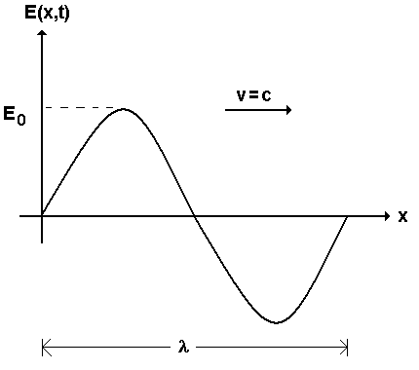
DAY 1: BASIC SPECTROSCOPY
1.1 Light as waves 1.2 Interference 1.3 Diffraction 1.4 The GRISM
1.1 Light as waves
Sinusoid wave
Amplitude
Period (s)
T=λ/ v
Wave number
k=2π/λ
Angular frequency
ω=2π/Τ.

Slide 5
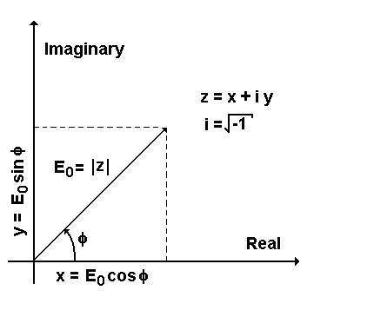
A wave by complex mathematics
Euler’s formula
Real part of is
In 3D a wave is expressed as
is the initial phase of the wave

Slide 6
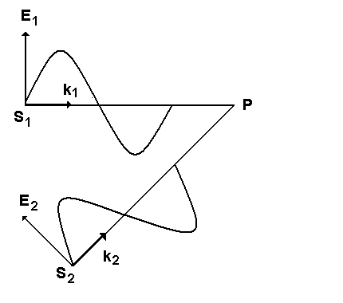
DAY 1: BASIC SPECTROSCOPY
1.1 Light as waves 1.2 Interference 1.3 Diffraction 1.4 The GRISM
1.2 Interference
Two wave sources
Amplitudes
Intensity
Phases
Phase difference
Constructive interference
Destructive interference

Slide 7
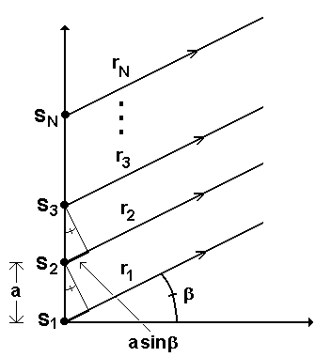
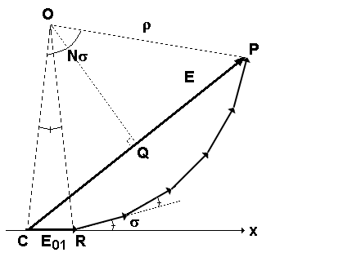
Several wave sources
Amplitudes
Phase difference between waves
Distance P much larger than a then we can use
the rotating vector sum to get the total E at P.
Triangle QCR gives

Slide 8
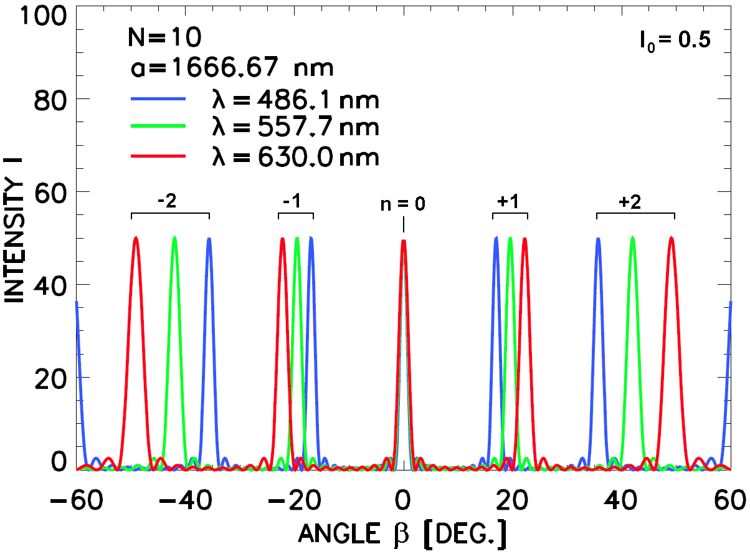
Eliminating ρ
The intensity is proportional to E²
Example N = 10
Maxima
N²I₀
Zero intensity
N-2 minima between peaks
Half widths of peaks

Slide 9
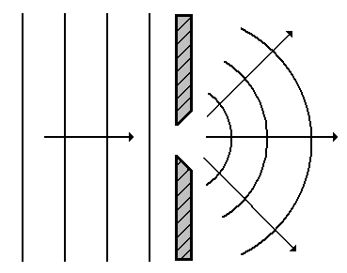
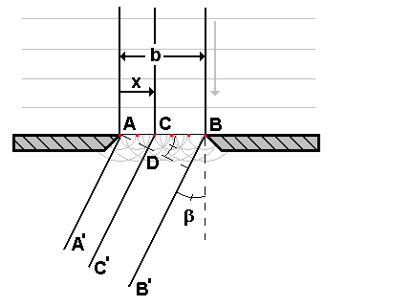
DAY 1: BASIC SPECTROSCOPY
1.1 Light as waves 1.2 Interference 1.3 Diffraction 1.4 The GRISM
1.3 Diffraction
Diffraction may be seen as the interference
of a finite wave itself.
Example of diffraction: Ocean waves hitting a port entrance wall.
Huygens principle state that every point of a wave front can be thought of as the source of secondary wavelets.
These new waves are defined as the diffracted waves, each with amplitude dE₀₁.
The phase difference between CC’ and AA’
The single slit.

Slide 10
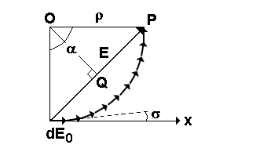
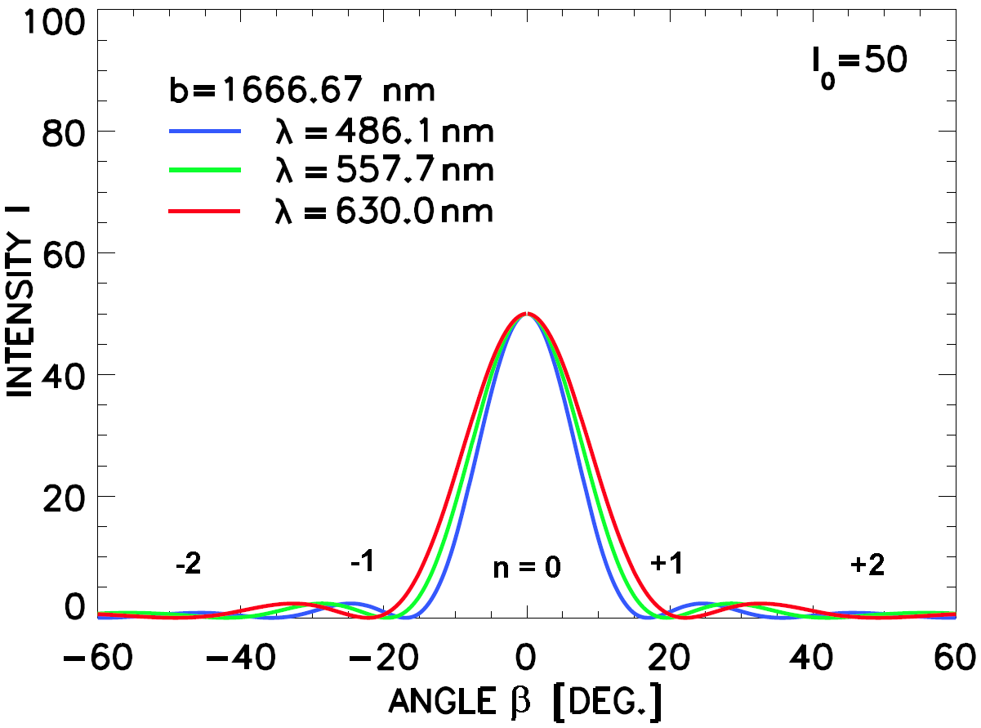
The rotating vector sum
When β = 0
Example
Minima
I₀
Maximum
u = 0
Red wavelengths are more diffracted than blue

Slide 11
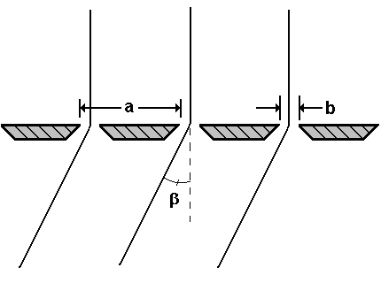
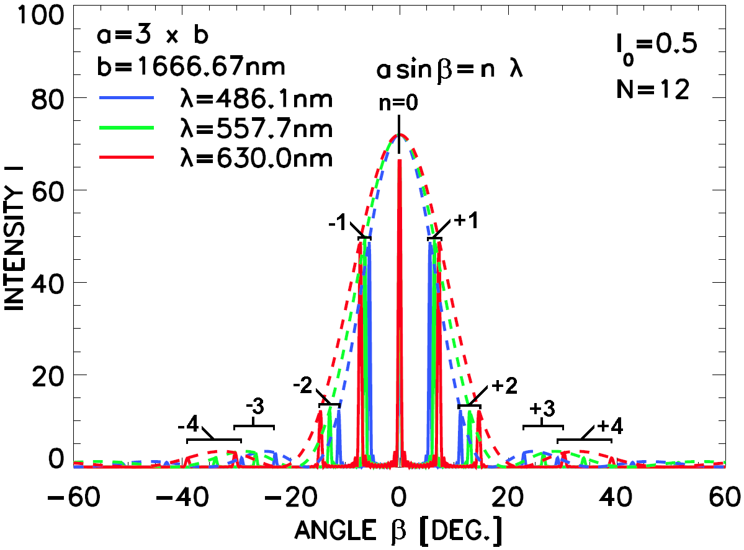
The diffraction grating
The net intensity is simply interference caused by N slits, modulated by the diffraction pattern of one single slit
Example
Note that for each wavelength we obtain maxima at different angles except for zero order.
This is the same for all wavelengths. Or in other words, we obtain spectra on each side of zero order.
Also note that the location of the intensity maxima for each order increases for increasing wavelength.

Slide 12
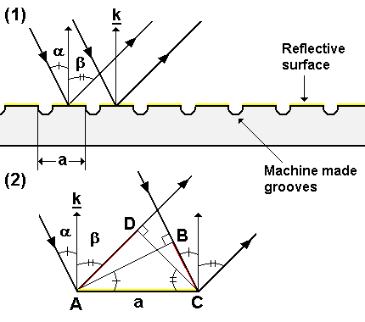
The reflective grating
The plane reflective grating may be thought of as a polished surface that has parallel grooves which have been made by a sharp diamond.
The grating consists of narrow parallel mirrors, where each mirror acts a source of interference in the same manner as described before.
The phase difference between each source due to path difference
Maxima occurs at
The grating equation
Littrow condition

Slide 13
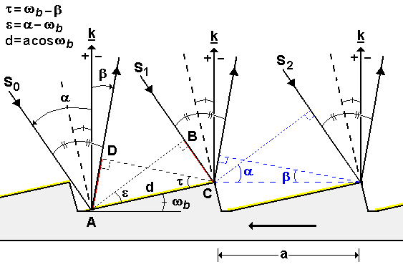
The blazed grating
Note that so far most of the intensity is diffracted into the zero order. If the reflective surfaces are tilted at an angle ω_{b} to the grating normal k, we have a blazed grating. ω_{b} is known as the blaze angle.
Also, note that the phase difference between the rays S₁ and S₂, as a result of the grooves, is the same as before. This means that the interference pattern is not shifted in angle, and that the grating equation still holds.

Slide 14
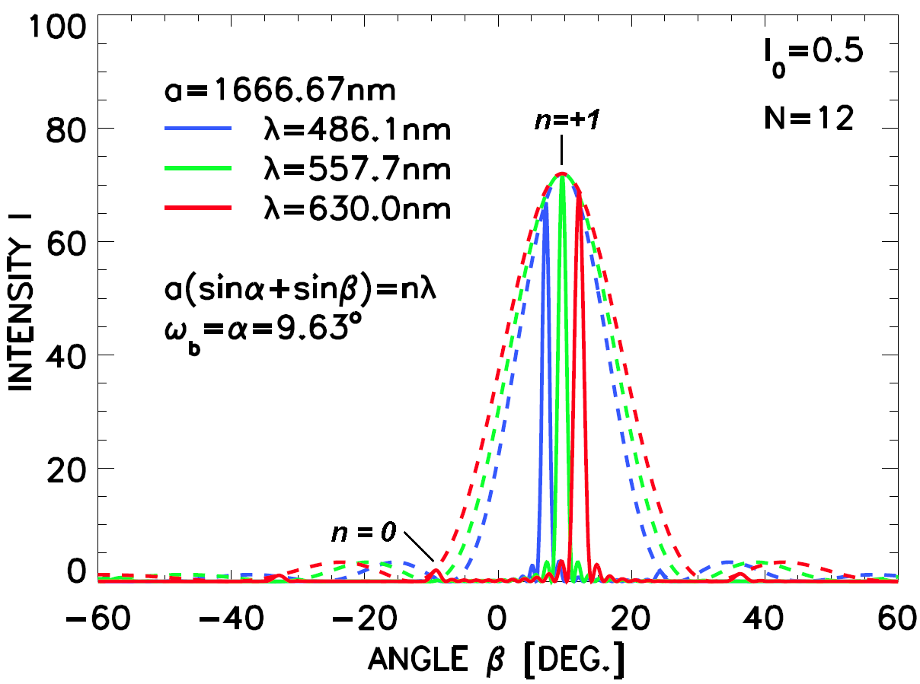
Example blazed grating
Most efficient when
Each surface will act as a small mirror, reflecting the rays with equal angles from the groove normal.
The blaze wavelength

Slide 15
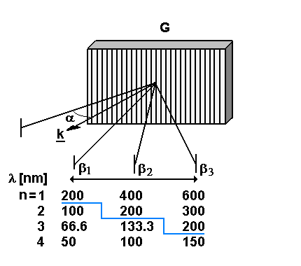
Overlapping spectral orders
The grating equation
The overlapping wavelengths are a multiple of the factor (1/n) from the grating equation
Air at ground level absorbs light below ~190 nm.
If you, for example, need to make a first order measurement in the visible spectral range 400 to 600 nm, then you will need to block out second order overlapping wavelengths from 200 to 300 nm.
Resolving power
It is a theoretical measure of a grating’s ability to separate adjacent spectral lines. For example, a resolving power of R=(600 grooves/mm)x12mm = 7200, will result in Δλ=0.07nm at λ=500nm for n=1.

Slide 16
Resolving power?
Previously (several sources interference)
The closest phase change from zero to maximum intensity:
Differentiating:
Rearranging:

Slide 17
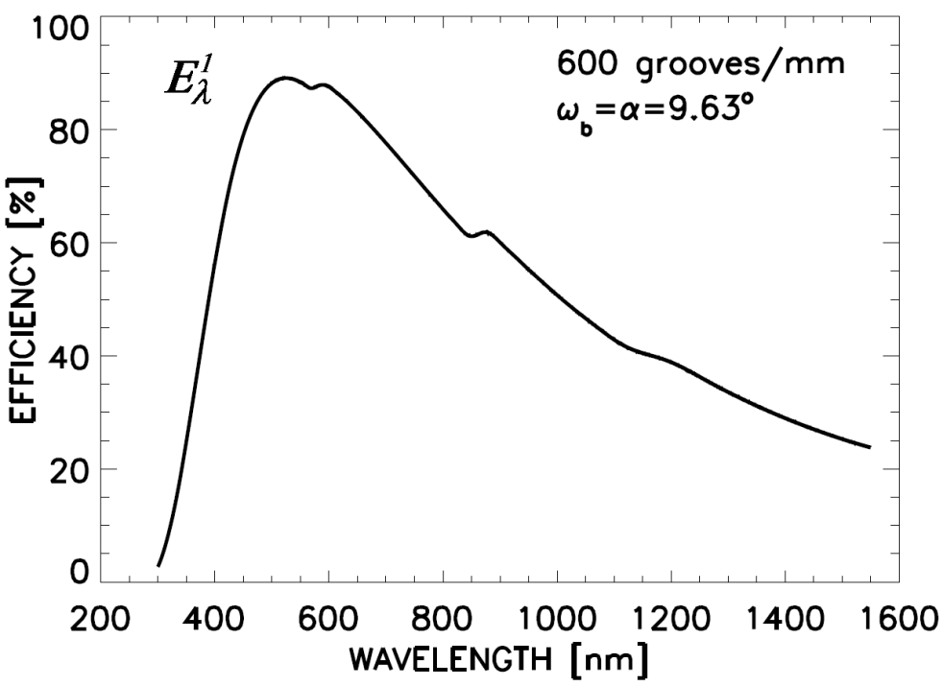
Angular dispersion
Differentiating the grating equation gives the angular dispersion
It is a measure on how rays spread out in a diffracted angle per unit wavelength, and it plays a key role in the calculation of the instrumental bandpass. Note that the angular dispersion increases with order.
Grating efficiency
Theoretical efficiency for a grating with 600 grooves / mm and a blaze angle ω_{b} = α = 9.63º. The blaze wavelength λ_{b} = 557.7 nm for n = 1.

Slide 18
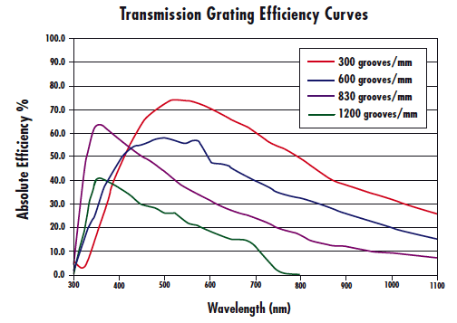
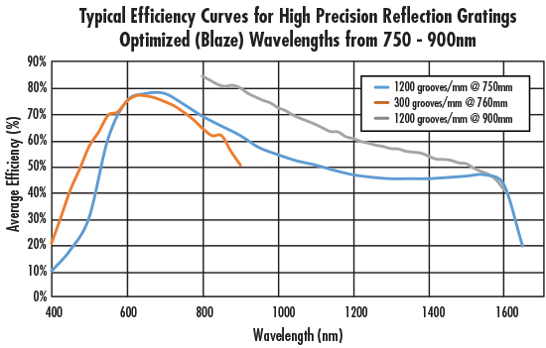
Grating efficiency

Slide 19
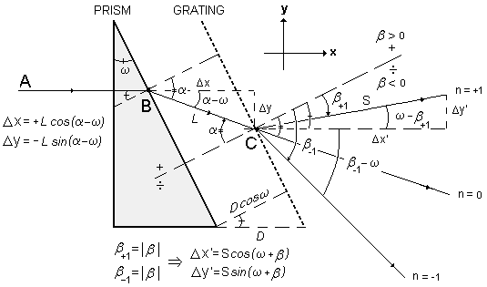
DAY 1: BASIC SPECTROSCOPY
1.1 Light as waves 1.2 Interference 1.3 Diffraction 1.4 The GRISM
1.4 The GRISM
A prism stacked in series with a transmission grating forms a diffractive element known as the GRISM or the Carpenters prism.
Key equations
Snell’s law
Straight through wavelength
Cauchy’s formula
The modified grating equation
Note that a prism disperses blue light more than red, whereas the grating diffracts red light more than blue.

Slide 20
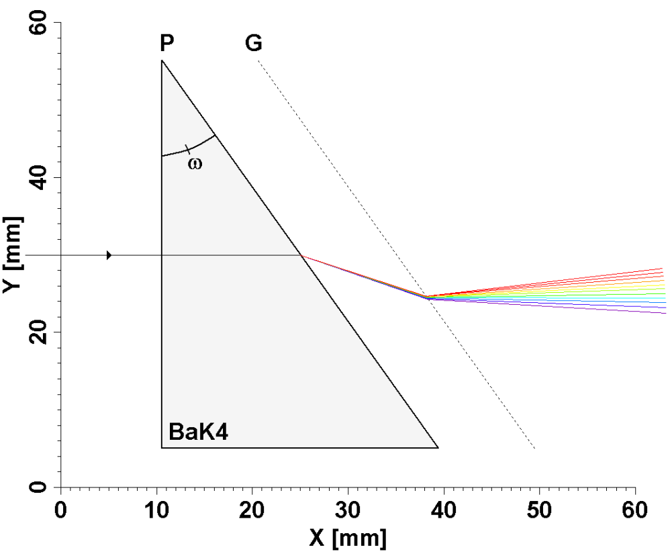
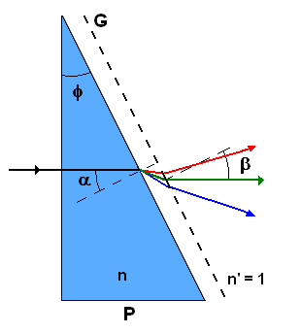
Example GRISM
Computer generated ray tracking for GRISM. P is wedged prism with ω = 30º. G is 600 lines/mm grating. First order spectral range: 400 – 700 nm
The prism material is Barium Crown (BaK4).
Note that the yellow - green wavelength close to ~500 nm passes straight through the GRISM, parallel to the x-axis. This on-axis effect of the GRISM is favorable due to the simplicity to stack additional optics on both the front and back side of it. Image quality will be preserved due to negligible off-axis effects.
The GRISM has increased angular dispersion compared to using a grating alone

Slide 21
THE GRISM
Angular dispersion?

