Slide 1
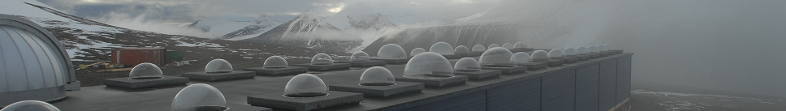

Status of the Kjell Henriksen Observatory (KHO) auroral forecast service
F. Sigernes ¹, S. E. Holmen ¹, M. Dyrland ¹, A. L. Bækken ², P. Brekke ³,
S. Chernouss ⁴, D.A. Lorentzen ¹, and C. S. Deehr ⁵
¹ The University Centre in Svalbard (UNIS), N-9171 Longyearbyen, Norway
² University of Oslo, Oslo, Norway
³ Norwegian Space Centre, Oslo, Norway
⁴ Polar Geophysical Institute, Murmansk Region, Apatity, Russia
⁵ Geophysical Institute, University of Alaska, Fairbanks, USA
The 9th European Space Weather Week, Brussels, Belgium, 5-9 November, 2012.

Slide 2
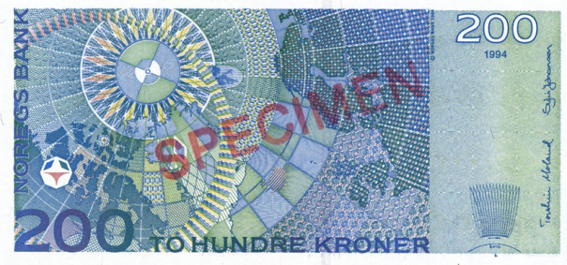

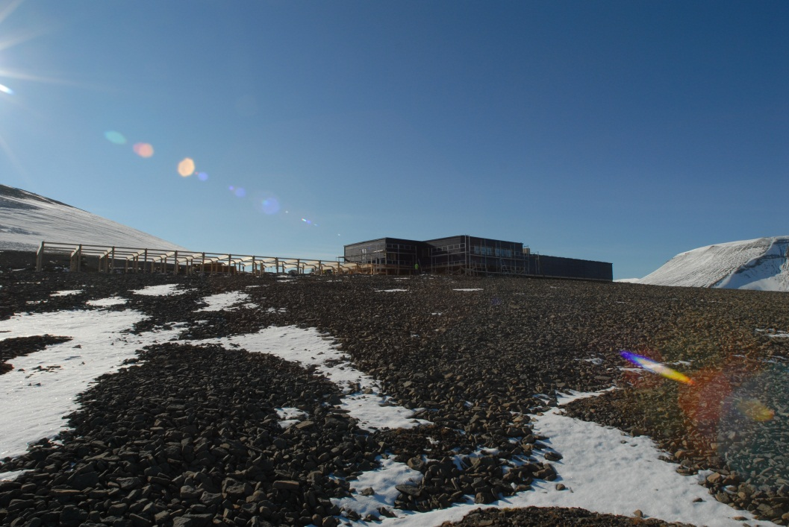
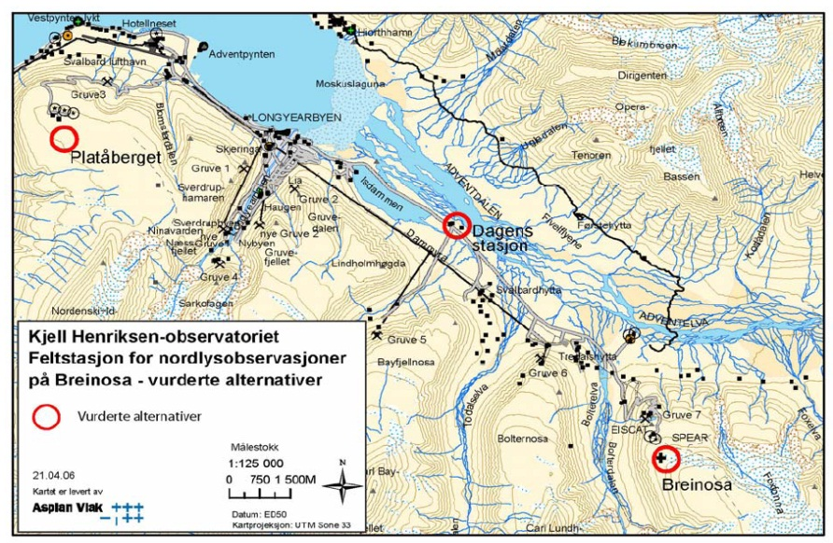
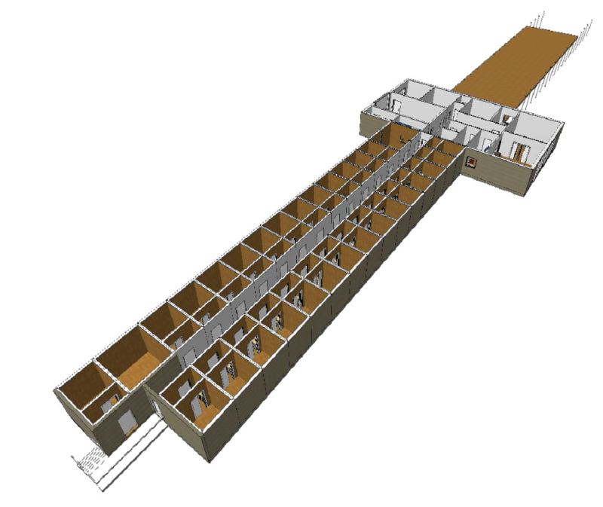

THE KJELL HENRIKSEN
OBSERVATORY – KHO 2008 -
Summer view
KHO
1) Instrumental module (30x)
2) Service Section
3) Platform
More info at: http://kho.unis.no
Prof. Dr ² K. Henriksen

Slide 3
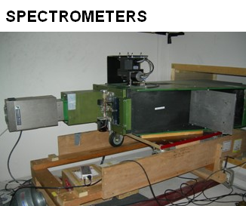
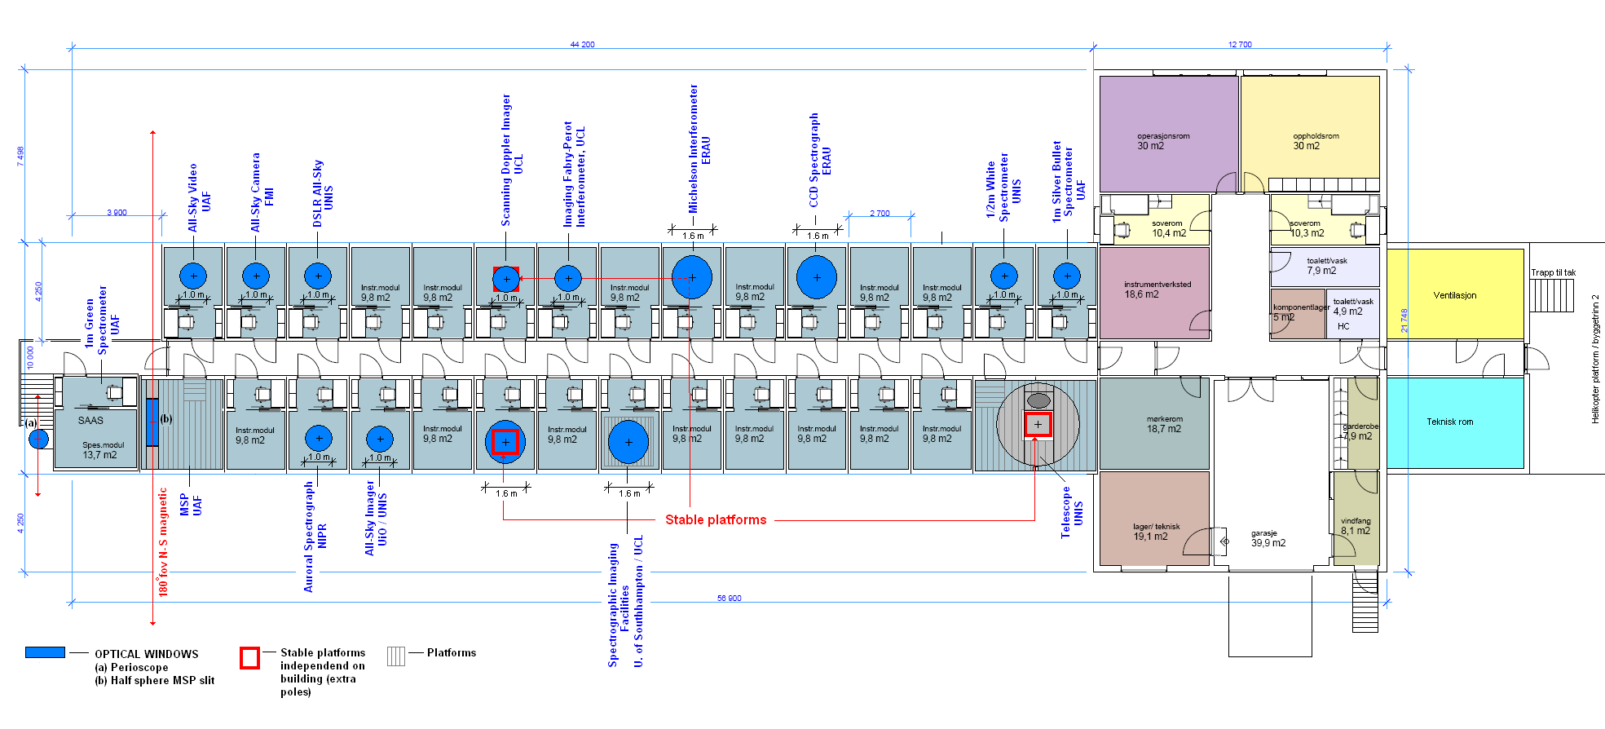
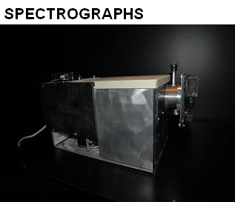
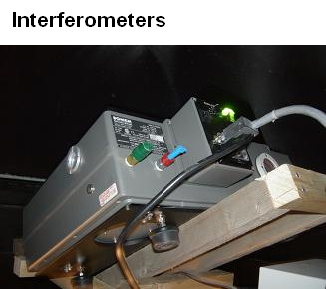
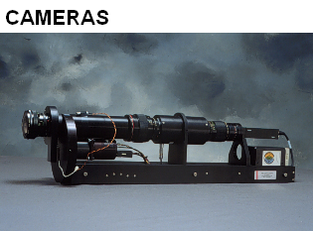
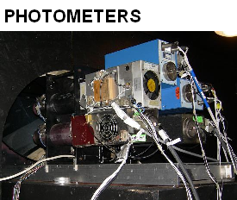
Instruments @ KHO
TELESCOPE
IN ADDITION
Magnetometers
Scintillation receivers (GPS)
Riometer
Weather station
Web cameras

Slide 4

Institutions @ KHO
University Centre in Svalbard
University of Oslo
University of Tromsø
University of Alaska, Fairbanks
University College London
University of Wales Aberystwyth
University of Southampton
University of New Hampshire
Augsburg College
Tohoku University
National Institute of Polar Research Japan
Finnish Meteorological Institute
Embry Riddle Aeronautical University
Danish Meteorological Institute *
Air Force Research Laboratory *
Laboratoire de Planétologie de Grenoble
Institute of Radio Astronomy
AVINOR
The Polar Institute of China
The University of Electro-Communications Tokyo
The 10 Nations @ KHO
… & excellent students!

Slide 5
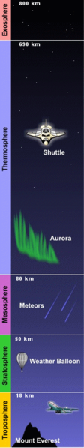
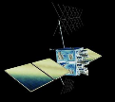
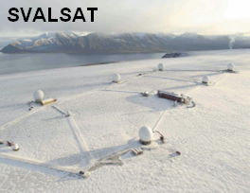
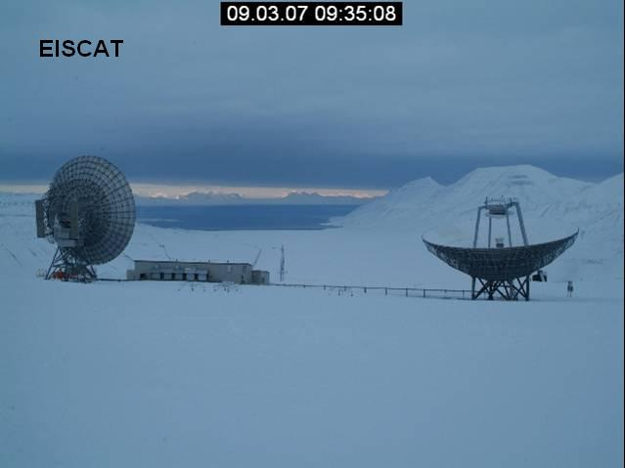
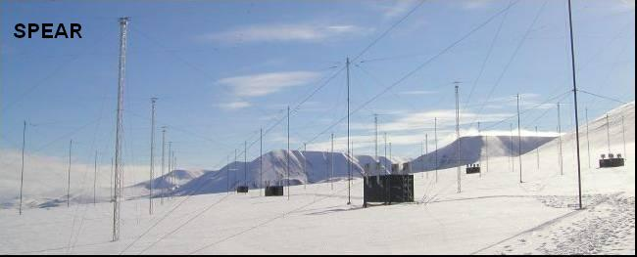
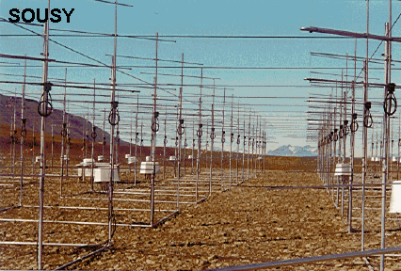
PARTNERS @ LYR
INTERNET
KHO - UNIS – ARS - MINE 7

Slide 6
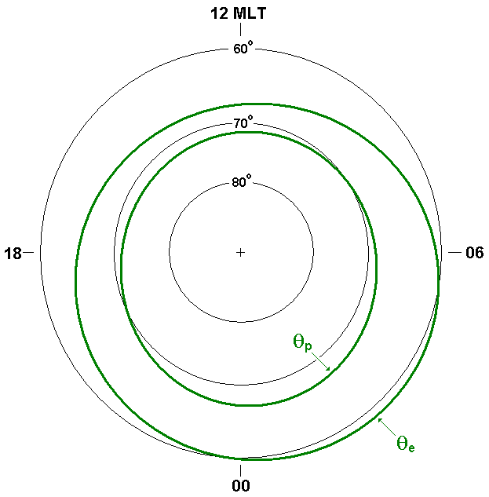
2 MATEMATICAL REPRESENTATIONS OF THE AURORAL OVALS
METHOD A: The Feldstein-Starkov ovals
Poleward and equatorward boundaries of auroral oval in geomagnetic co-latitude:
where amplitudes A_{i} and phases α_{i} is given by
The AL index is the max negative excursion of the H component from several ground based magnetometers.
It relates to the planetary Kp index by
REFERENCES
[1] Starkov, G. V., Mathematical model of the auroral boundaries,
Geomagnetism and Aeronomy, 34, 3, 331-336, 1994.
[2] Starkov, G. V., Statistical dependences between the magnetic activity indices, Geomagnetism and Aeronomy, 34, 1, 101-103, 1994.

Slide 7
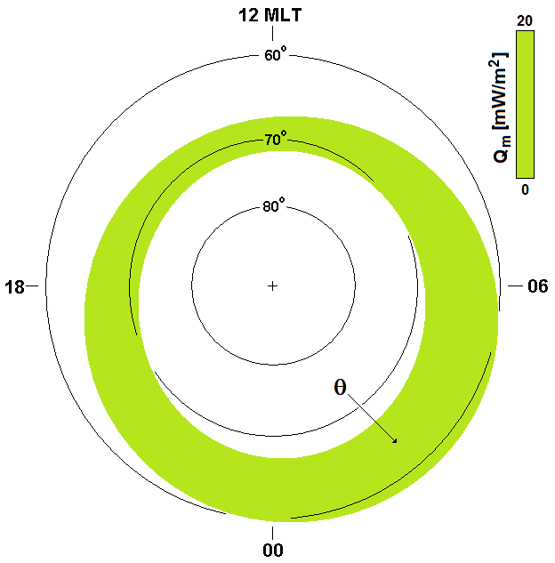
2 MATEMATICAL REPRESENTATIONS OF THE AURORAL OVALS
METHOD B: The Zhang-Paxton ovals
The electron energy flux is derived from
GUVI imager data (TIMED satellite)
where x is co-magnetic latitude.
The coefficients A’ is are calculated as
The coefficients b’ is tabulated as a function of six sub-intervals (m) of Kp index.
REFERENCE
[3] Zhang Y., and L. J. Paxton, An empirical Kp-dependent global auroral model based on TIMED/GUVI data, J. Atm. Solar-Terr. Phys., 70, 1231-1242, 2008.

Slide 8
GEOGRAPHICAL TRANSFORM
Cartesian components:
- is the longitudinal difference
between the sub-solar point and
the magnetic poles at time t (hours).
Geographical coordinates:
Latitude and longitude:

Slide 9
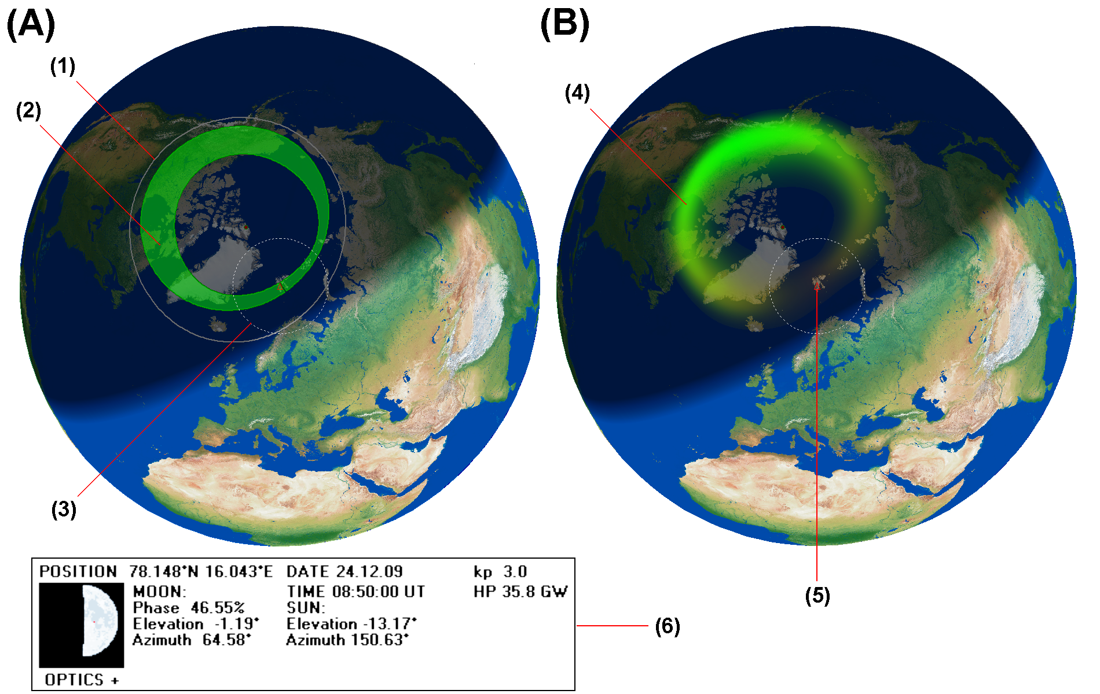
VISUALIZATION
The ovals are visualized with a stand alone 32-bit executable Windows program called
SvalTrackII.
The program is written in Borland Delphi 5 – Pascal and uses a Geographic Information system (GIS) unit called TGlobe.
Includes:
Method A
Equatorward boundary of the diffuse aurora
Feldstein & Starkov oval
Field of view aurora observer
Method (B)
(4) Zhang & Paxton oval
(5) Observer location
(6) Moon and Sun information at local site
The twilight zone, night- and dayside of
the Earth are projected with grades of
shade on the Globe as a function of time.

Slide 10
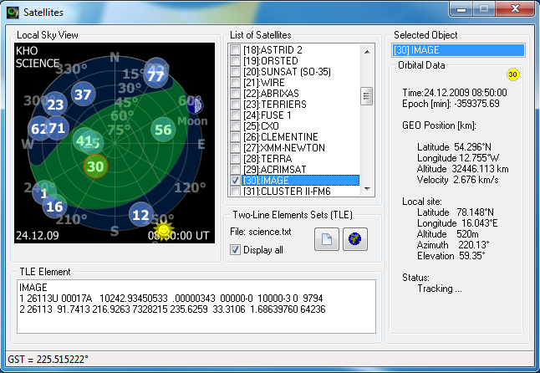
VISUALIZATION
All-Sky
Satellite View
Local auroral oval &
satellite all-sky view
Based on
Feldstein & Starkov and TLE element SGP4 code by [4]
[4] Vallado, D. A., P. Crawford, R. Hujsak, and T. S. Kelso, Revisiting Space track Report #3, American Institute of Aeronautics and Astronautics (AIAA), Report No. AIAA 2006-6753, 1-88, 2006.

Slide 11
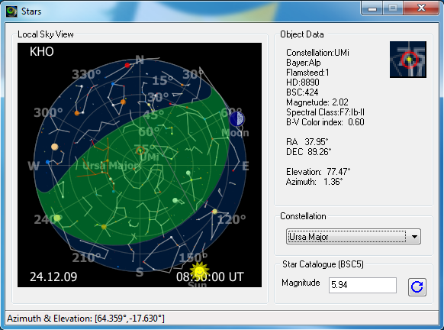
VISUALIZATION
NEW!
All-Sky
Star View
Local auroral oval &
star map all-sky view
Based on
Feldstein & Starkov ovals and Sky Charts software by [5]
Catalog: BSC5
[5] Cartes du Ciel, http://www.ap-i.net/skychart/

Slide 12
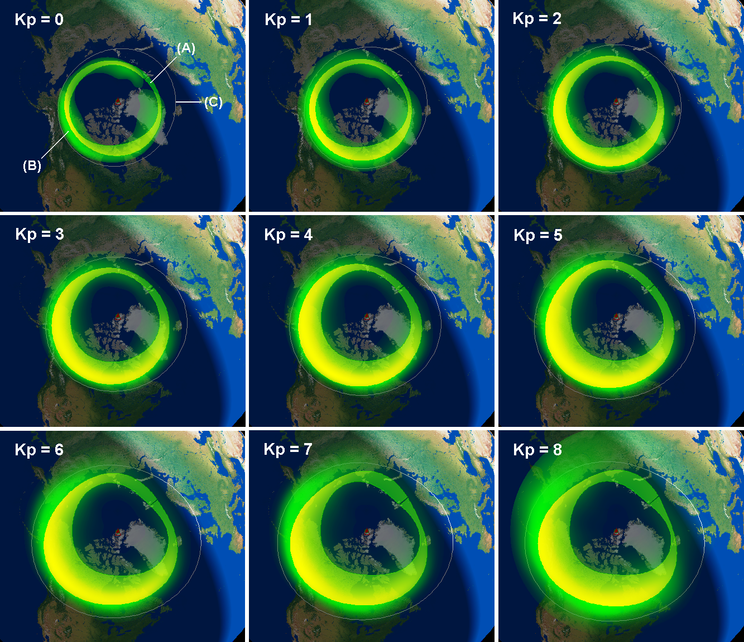
VISUALIZATION
ANIMATION
Animated aurora ovals as a function of Kp index [0…8] at 08:50 UT, 24th December 2009

Slide 13
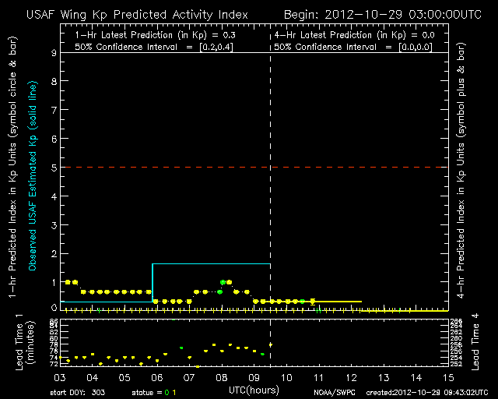
THE +1 or +4 HOUR PREDICTED Kp INDEX
SOURCE: Space Weather Prediction Centre (SWPC) at the National Oceanic
and Atmospheric Administration (NOAA).
The Wing Kp predicted Activity Index model.
Reference
Wing, S., J. R. Johnson, J. Jen, C.-I. Meng, D. G. Sibeck, K. Bechtold, J. Freeman, K. Costello, M. Balikhin, and K. Takahashi, Kp forecast models, J. Geophys. Res., 110, A04203, doi:10.1029/ 2004JA010500, 2005.
It is a neural network algorithm that trains on the response of the Kp geomagnetic activity index to solar wind parameters / data. It predicts +1 or+ 4 hours ahead.
The model returns an one hour prediction in units of Kp. It updates / predicts every 15 minutes.
15 minutes oval update:
http://kho.unis.no
http://www.swpc.noaa.gov/wingkp/

Slide 14
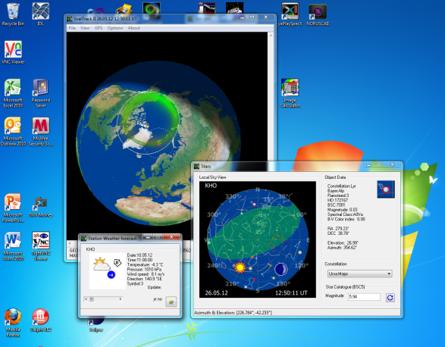
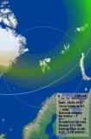
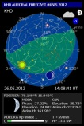
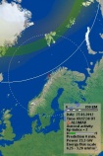
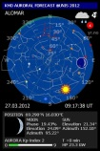

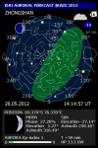

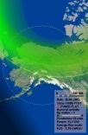
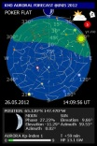
THE KHO AURORAL OVAL FORECAST SERVICE
SERVER / PC
RUNS SVALTRACKII.EXE
WEB SERVER
http://kho.unis.no
Internet
Stations x 007
(60 sec.)
Kp index
NOAA-SWPC
(15 min. updates)
NEW
Weather forecasts
YR.NO (60 min.)
+1 or +4 hours predictions
Mobile Auroral forecast
applications (apps)

Slide 15

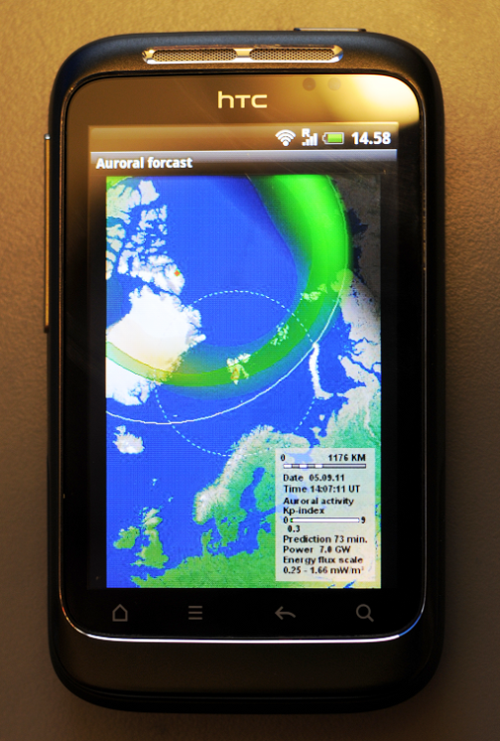


THE KHO MOBILE AURORAL OVAL FORECAST SERVICE
As part of the Andøya rocket range 50 years celebration
16th of August 2012, we released mobile applications for all smart phones:
Android
iPhone
Windows Phone
Company
http://appex.no
The auroral forecast on a HTC wildfire phone.

Slide 16
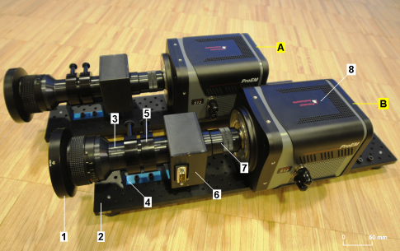
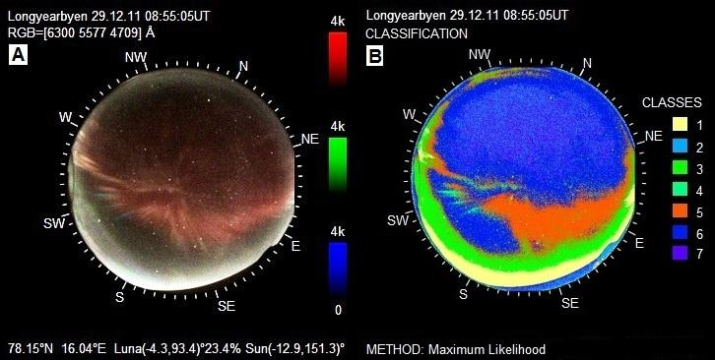
NORUSCA II Cameras
MULTI SITE HYPERSPECTRAL OPTICAL VALIDATION?
NEW data from KHO and Barentsburg ! (Media)

Slide 17
Some REMARKS and QUESTIONS
1) As expected the Zhang-Paxton ovals deduced by space borne data are wider than the ground based Feldstein-Starkov ovals.
2) In spite of difference in methods and platforms, the model ovals coincide fairly well in shape for low to normal conditions on the nightside.
3) The equatorward border of the diffuse aurora is well defined by both methods on the nightside for Kp<7.
4) On the dayside, there is a need to study further oval shapes for all levels of auroral activity, especially the equatorward border of the diffuse aurora.
5) Is it possible to derive / predict the Kp index from the Norwegian chain of magnetometers, as a real time service?
6) Can other data sources like our new HF radar looking east and future GPS scintillations receiver chains contribute?
7) Optical validation, local light pollution, etc., etc…

Slide 18
Acknowledgement
We wish to thank
1) The National Oceanic and Atmospheric Administration (NOAA) - Space Weather Prediction Centre for allowing us to download the predicted value of the K_{p} index every 15 minutes.
2) The Research Council of Norway through the project named: Norwegian and Russian Upper Atmosphere Co-operation On Svalbard part 2 # 196173/S30 (NORUSCA2).
3) The Nordic Council of Ministers: Arctic cooperation program # A10162.
PS!
The Svaltrack II program is fredware…it cost II beers.

