Slide 1
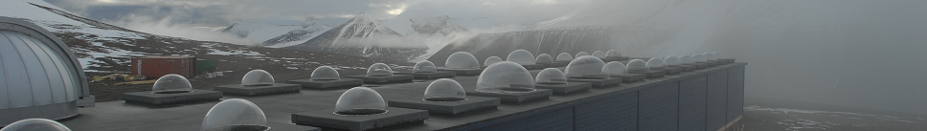

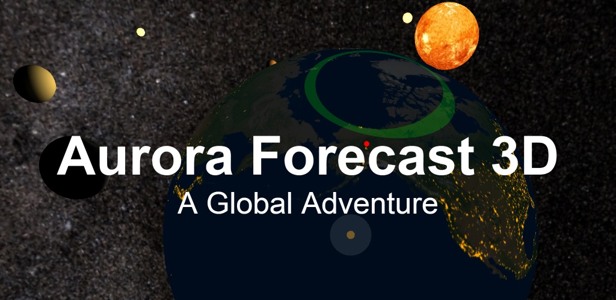
F. Sigernes ^{1,2,3}
¹ The University Centre in Svalbard (UNIS), N-9171 Longyearbyen, Norway
² The Birkeland Centre for Space Science (BCSS)
³ The Kjell Henriksen Observatory (KHO)
Birkeland Space Weather Symposium, 15-16 June, Oslo, Norway.

Slide 2
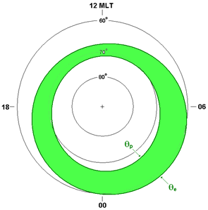
MATEMATICAL REPRESENTATIONS OF THE AURORAL OVALS
The Feldstein-Starkov ovals
Poleward and equatorward boundaries of auroral oval in geomagnetic co-latitude:
where amplitudes A_{i} and phases α_{i} is given by
The AL index is the max negative excursion of the H component from several ground based magnetometers.
It relates to the planetary Kp index by
The Kp is the predicted +1 and +4 hours index from the
Wing Kp model at NOAA-SWPC

Slide 3


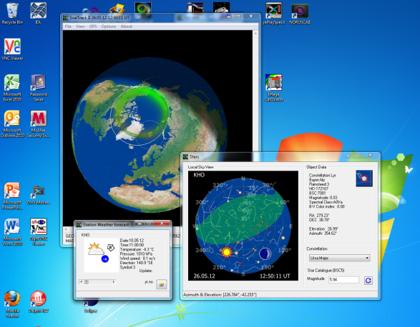
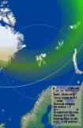
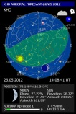
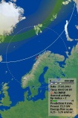
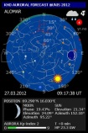

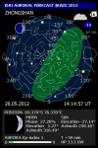

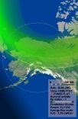
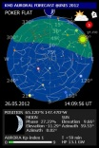
THE KHO AURORAL OVAL FORECAST SERVICE (2012 – 2017)
PC/
SERVER
WEB
Internet
Client unis.no
http://kho.unis.no
Kp index
NOAA-SWPC
(15 min. updates)
NEW: Aurora Forecast 3D
Stations x 007
(60 sec.)
14 images
Weather forecasts
YR.NO (60 min.)
+1 or +4 hours predictions
Mobile Auroral forecast
applications (apps)
Limitations: Only a fixed number of stations available!

Slide 4
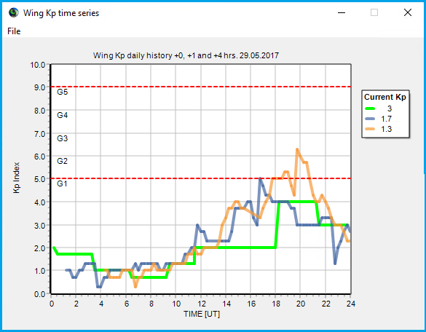
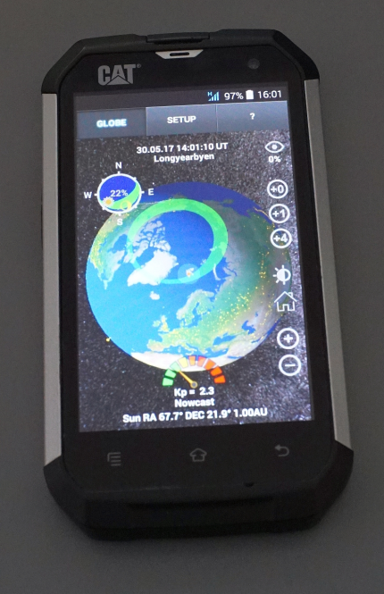
THE KHO AURORAL OVAL FORECAST 3D SERVICE (2017)
PC/
SERVER
WEB
Internet
Client unis.no
http://kho.unis.no
Kp index
NOAA-SWPC
(15 min. updates)
3 numbers
1 text line
Kp index server
Storm
Notifications
3 numbers
1 text line
The auroral forecast 3D

Slide 5
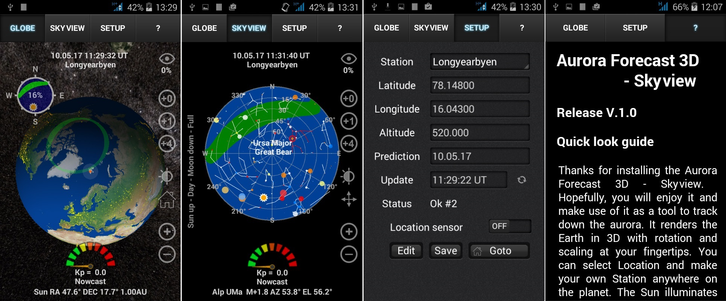
Aurora Forecast 3D - Snapshots
FEATURES
- 3D view port of Earth with zoom and rotation enabled.
- Solar illumination of the Earth and the Moon.
- Aurora oval size and location in real time. ^{[1,2]}
- Forecasts based on predicted NOAA-SWPC Kp index.
- Color scaled Kp speedometer.
- Aurora Compass sky view display.
- Editable station / location list.
- Go to animation.
- Right Ascension and Declination of planets. ^{[3]}
- Age of the Moon including the phase.
- Includes a 2.4 million star map. ^{[4]}
- City light texture. ^{[5]}
- Earth, Sun and Moon textures. ^{[6,7]}
- Skyview module to track planets and stars. ^{[8]}
- Geomagnetic storm alert notifications.

Slide 6



Downloads
Platform | Where | Link
Android Mobile | Google Play | Search for “Aurora forecast 3D”
Windows 32-bit PC | http://kho.unis.no | AuroraForecast3D_Win32.zip
Windows 64-bit PC | http://kho.unis.no | AuroraForecast32_Win64.zip
Apple OSX iMac | http://kho.unis.no | AuroraForecast32_OSX.zip
Apple iOS Mobile | Apple Store | Soon …
Acknowledgement
We wish to thank
The National Oceanic and Atmospheric Administration (NOAA) - Space Weather Prediction Centre for allowing us to download the predicted value of the K_{p} index every 15 minutes.
PS! The Aurora Forecast 3D is fredware….

Slide 7
References
[1] Sigernes F., M. Dyrland, P. Brekke, S. Chernouss, D.A. Lorentzen, K. Oksavik, and C.S. Deehr, Two methods to forecast auroral displays, Journal of Space Weather and Space Climate (SWSC), Vol. 1, No. 1, A03, DOI:10.1051/swsc/2011003, 2011.
[2] Starkov G. V., Mathematical model of the auroral boundaries, Geomagnetism and Aeronomy, 34 (3), 331-336, 1994.
[3] P. Schlyter, How to compute planetary positions, http://stjarnhimlen.se/ , Stockholm, Sweden.
[4] Bridgman, T. and Wright, E., The Tycho Catalog Sky map- Version 2.0, NASA/Goddard Space Flight Center Scientific Visualization Studio, http://svs.gsfc.nasa.gov/3572, 2009.
[5] The Visible Earth catalog, http://visibleearth.nasa.gov/, NASA/Goddard Space Flight Center, April-October, 2012.
[6] T. Patterson, Natural Earth III - Texture Maps, http://www.shadedrelief.com, 2016.
[7] Nexus - Planet Textures, http://www.solarsystemscope.com/nexus/, 2013.
[8] Hoffleit, D. and Warren, Jr., W.H., The Bright Star Catalog, 5th Revised Edition (Preliminary Version), Astronomical Data Center, NSSDC/ADC, 1991.

